Slide 1
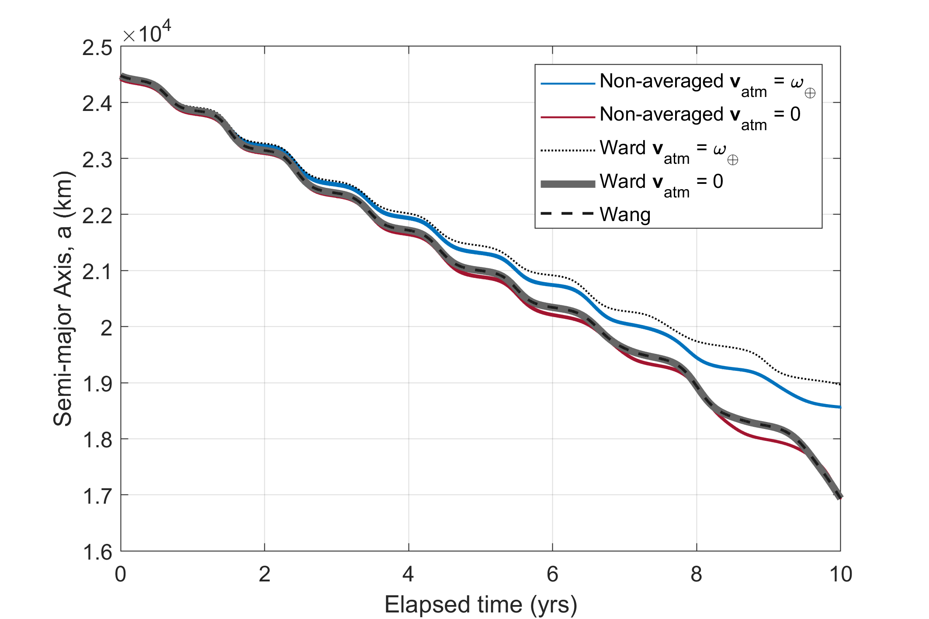
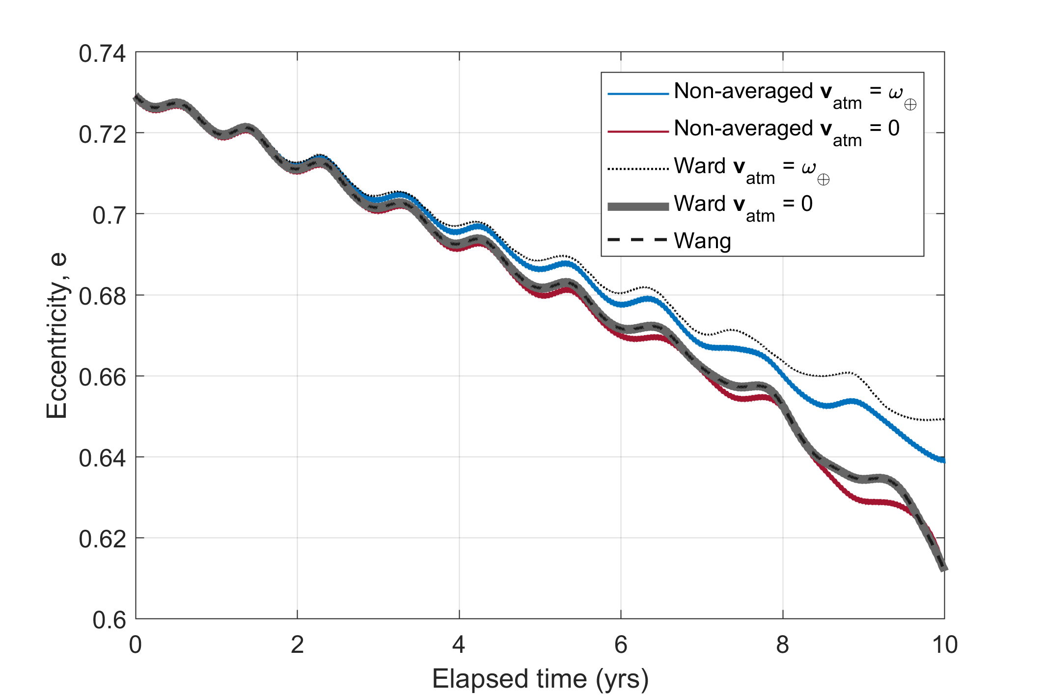
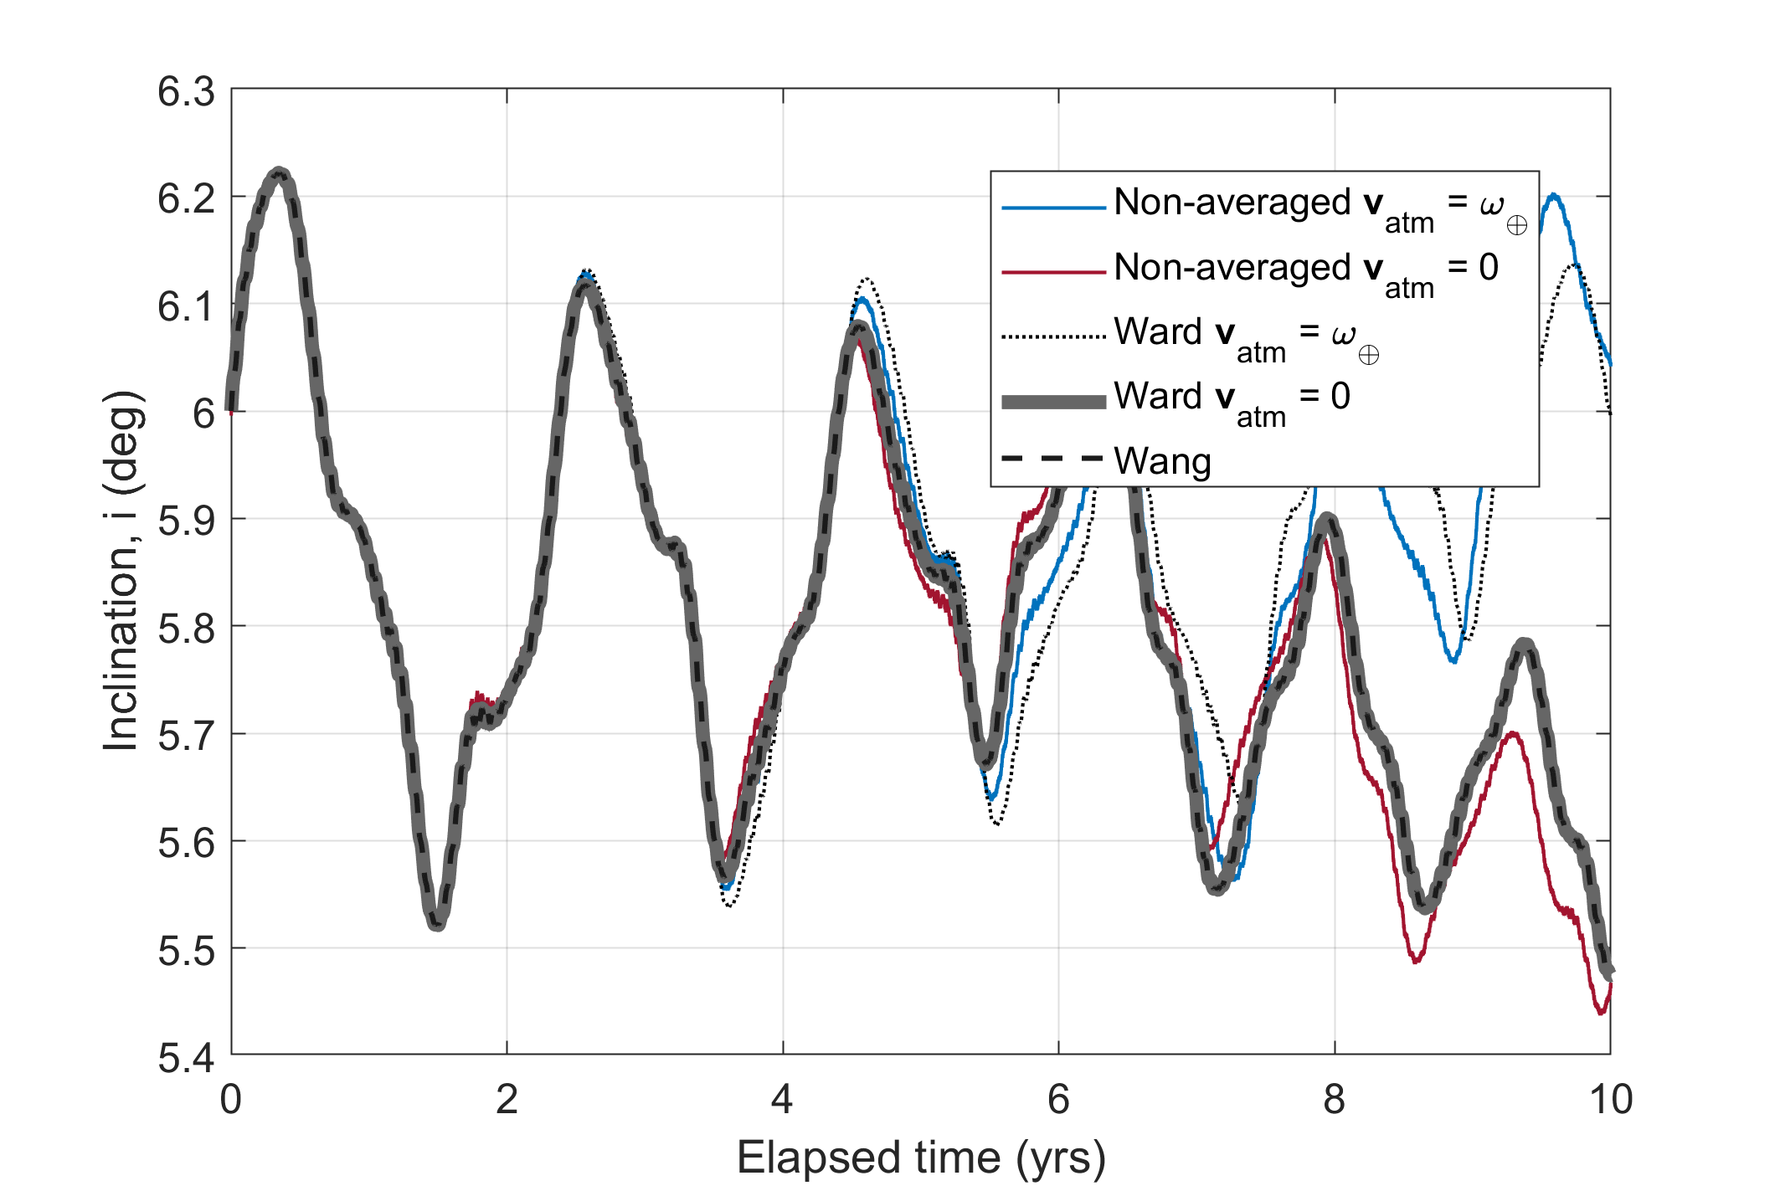
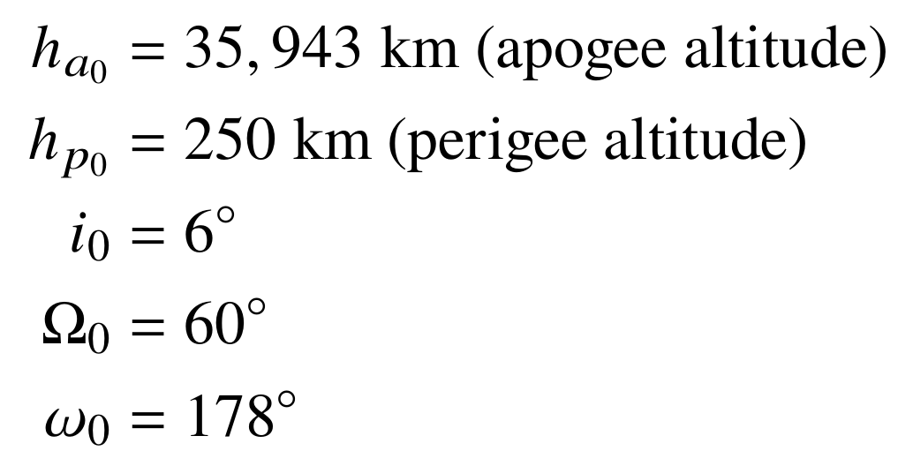
Initial Conditions:
GTO injection for typical Ariane 5 mission from Gurfil’s paper

Slide 2
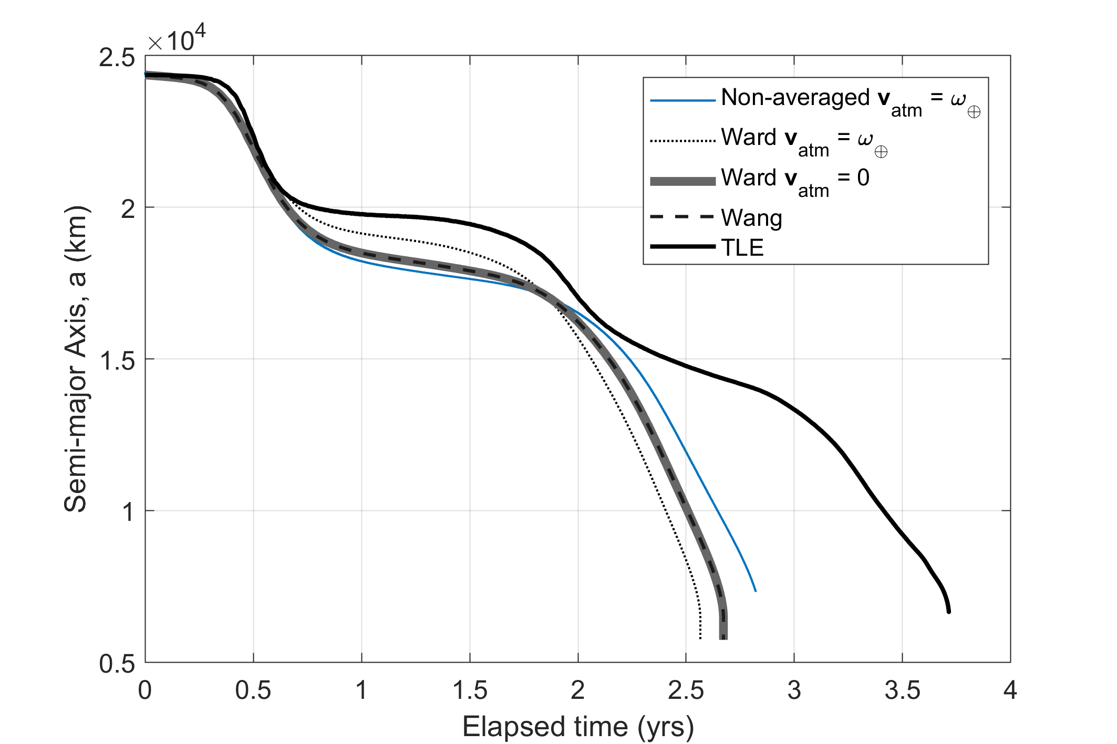
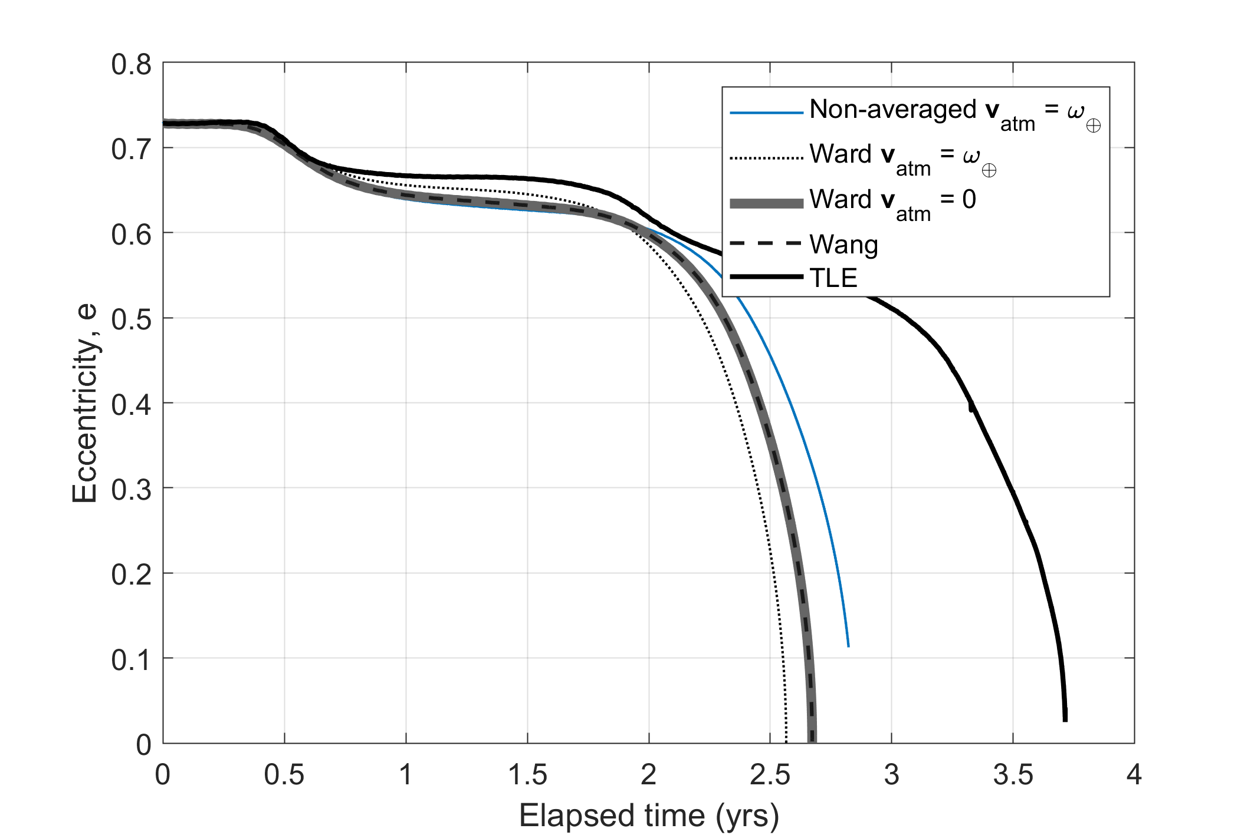
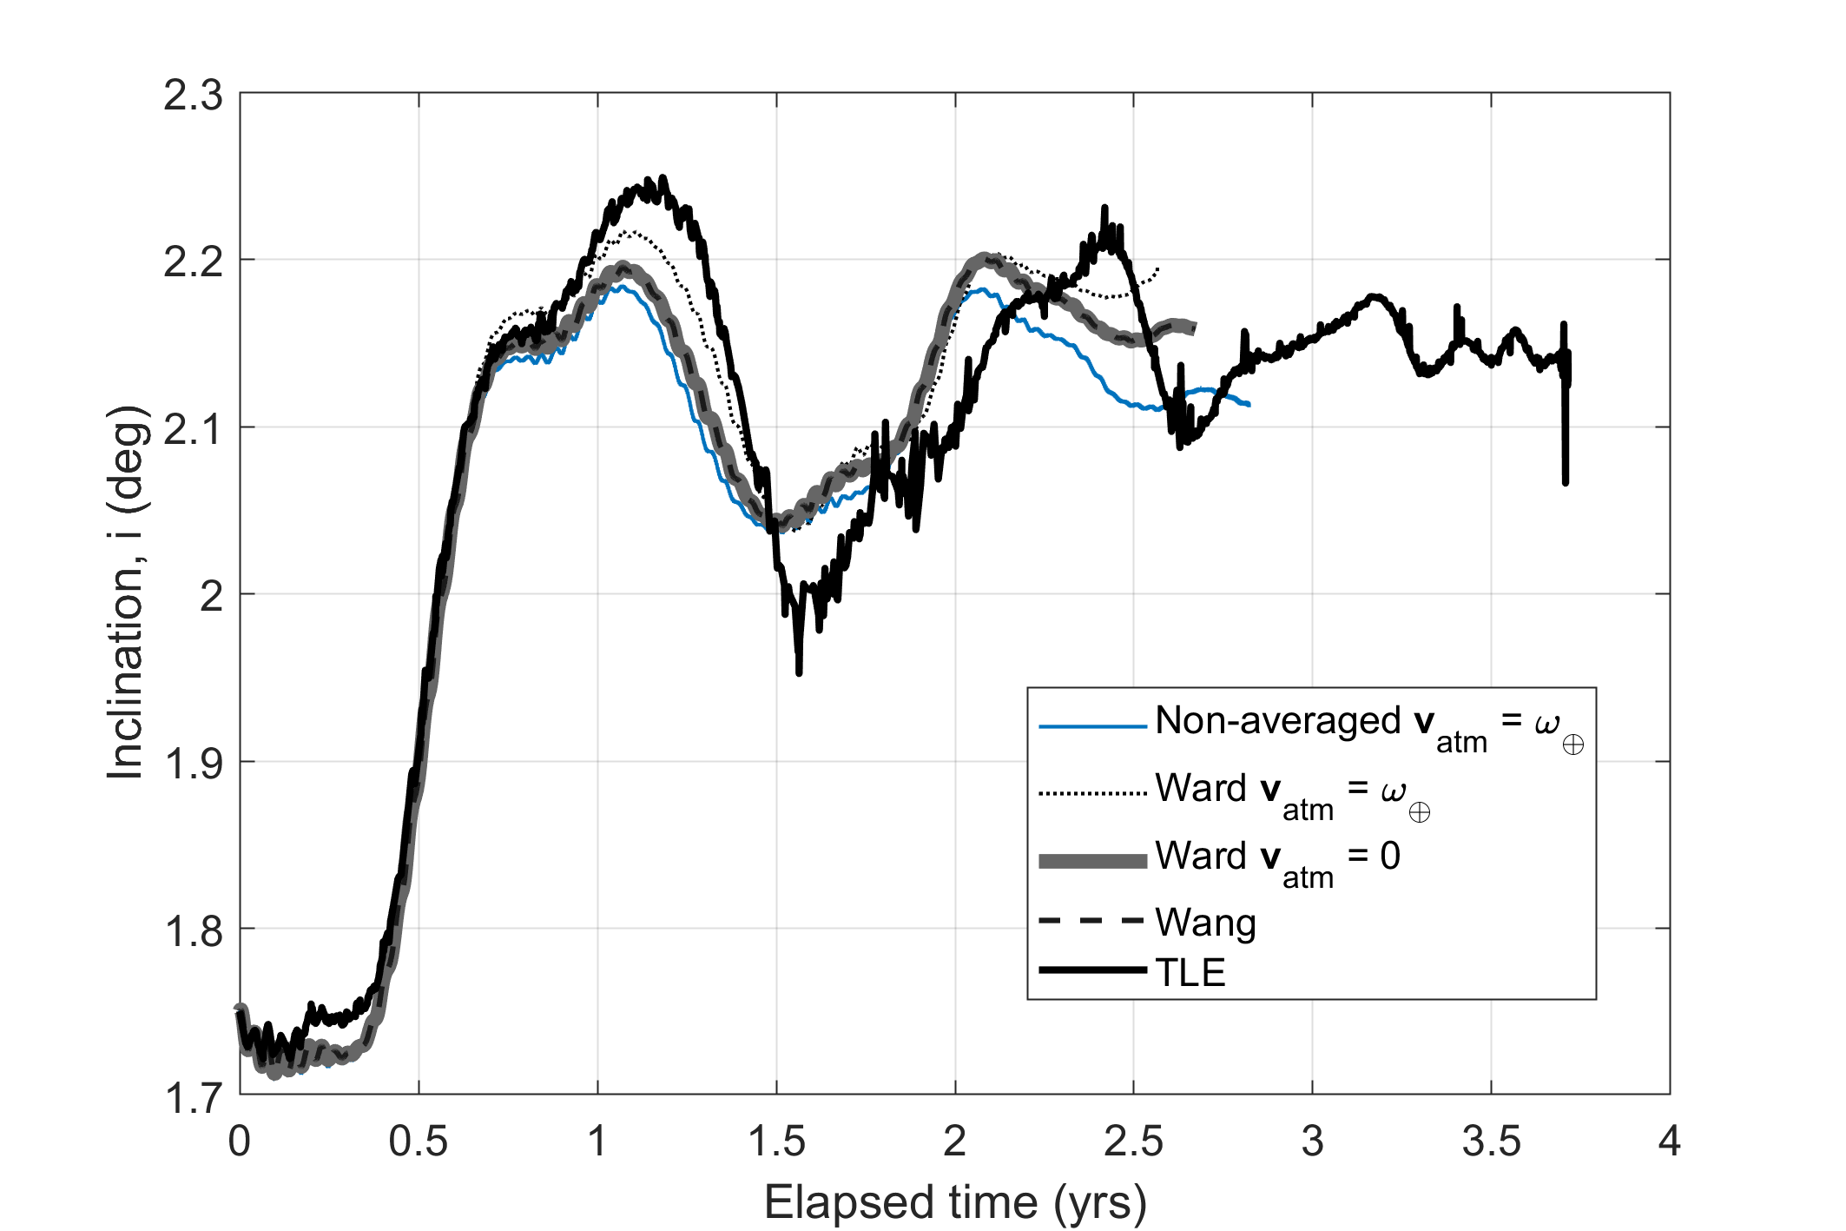
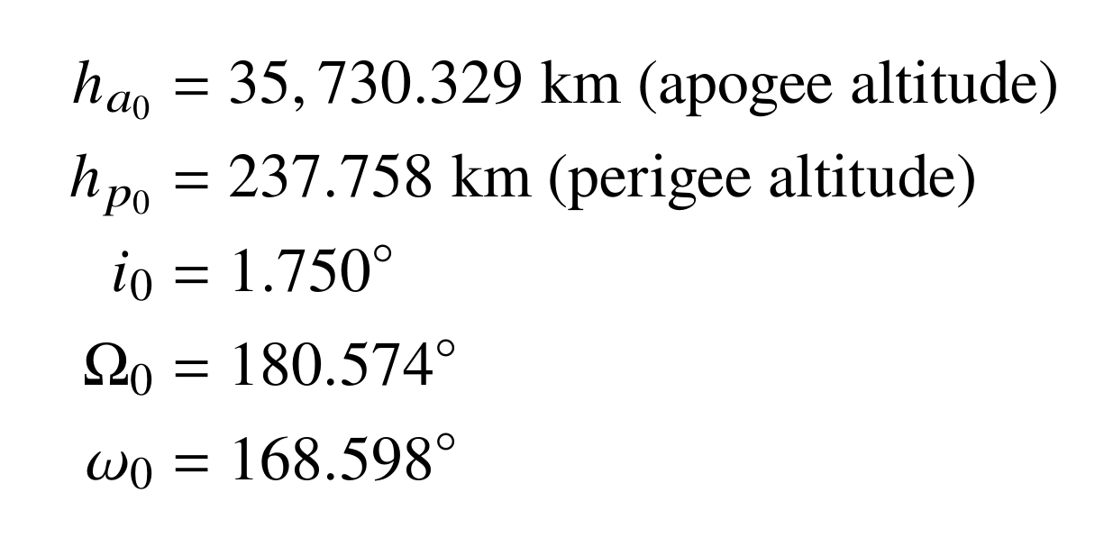
Why does Ward with atmospheric rotation perform worse than Wang which does not account for atmospheric rotation?
Initial Conditions:
From TLE for Ariane 5 R/B Norad ID: 37239

